Slide 1
TBS Box Office
Changing the way booking is done at the MLR Convention Center.
By Aditi.V and Suraj.A of class XII

Slide 2
Agenda
Booking of Seats by parents in MLR
Ticket Generated and QR code, email sent with details
Cancellation of Tickets by parents
Admin Ability to see reports
Blocking of seats by school
Visual representation of real time seat booking status

Slide 3
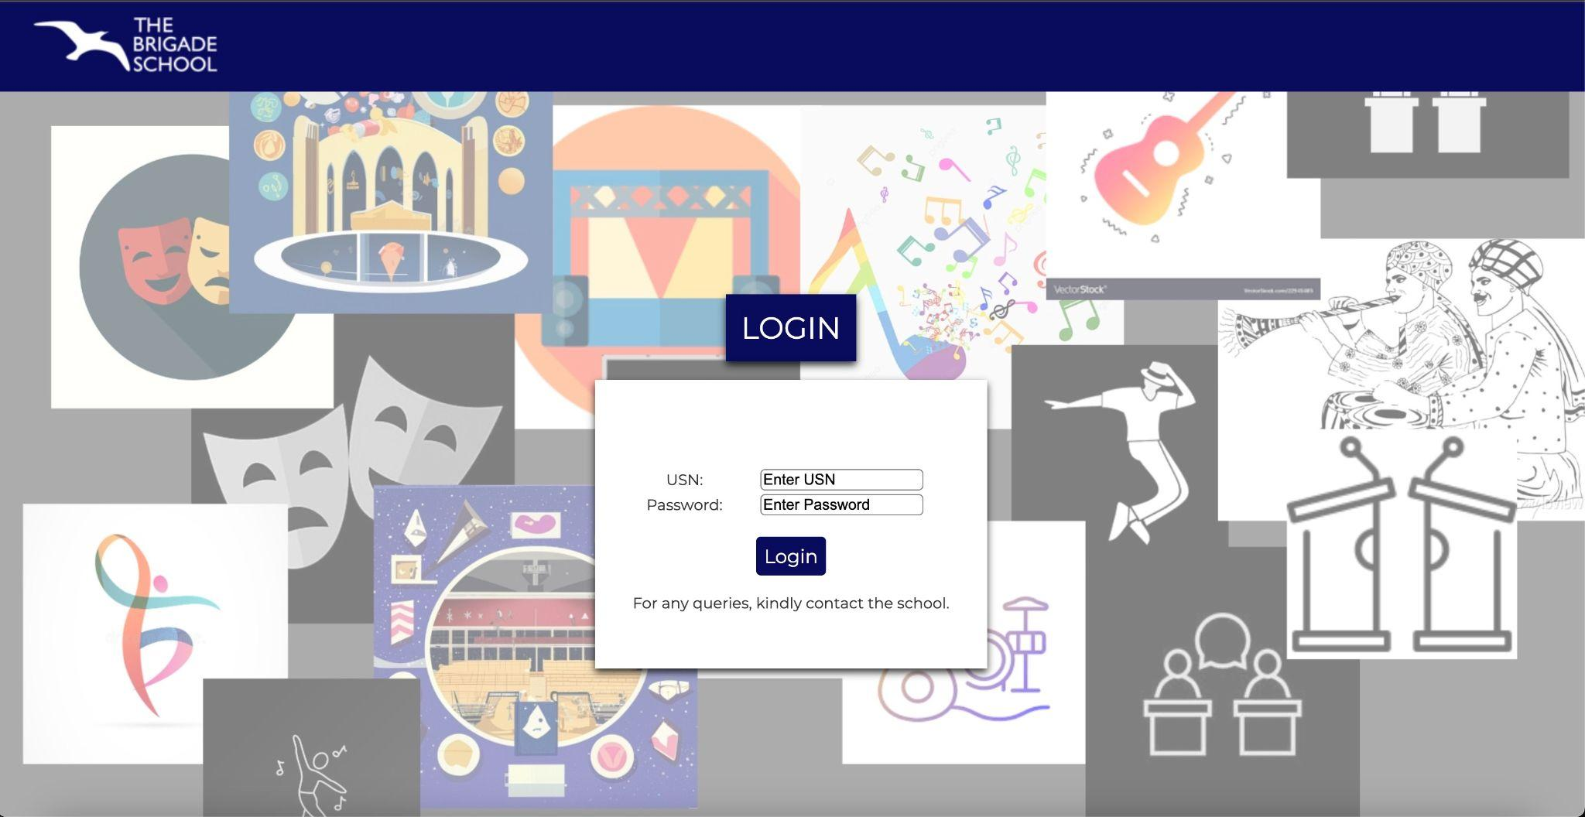
Login Page

Slide 4
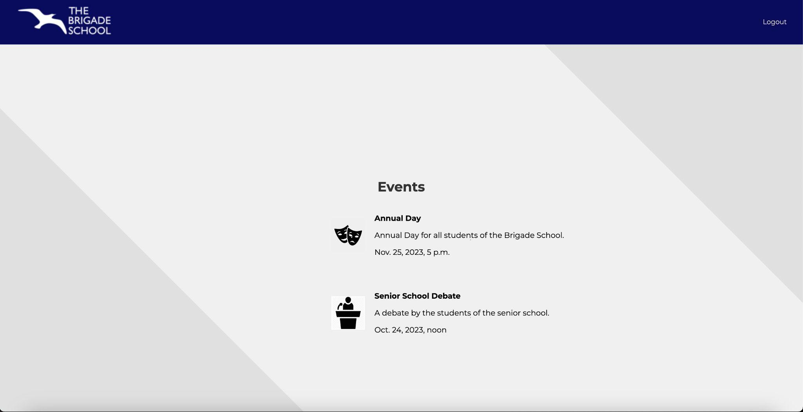
Event selection page

Slide 5
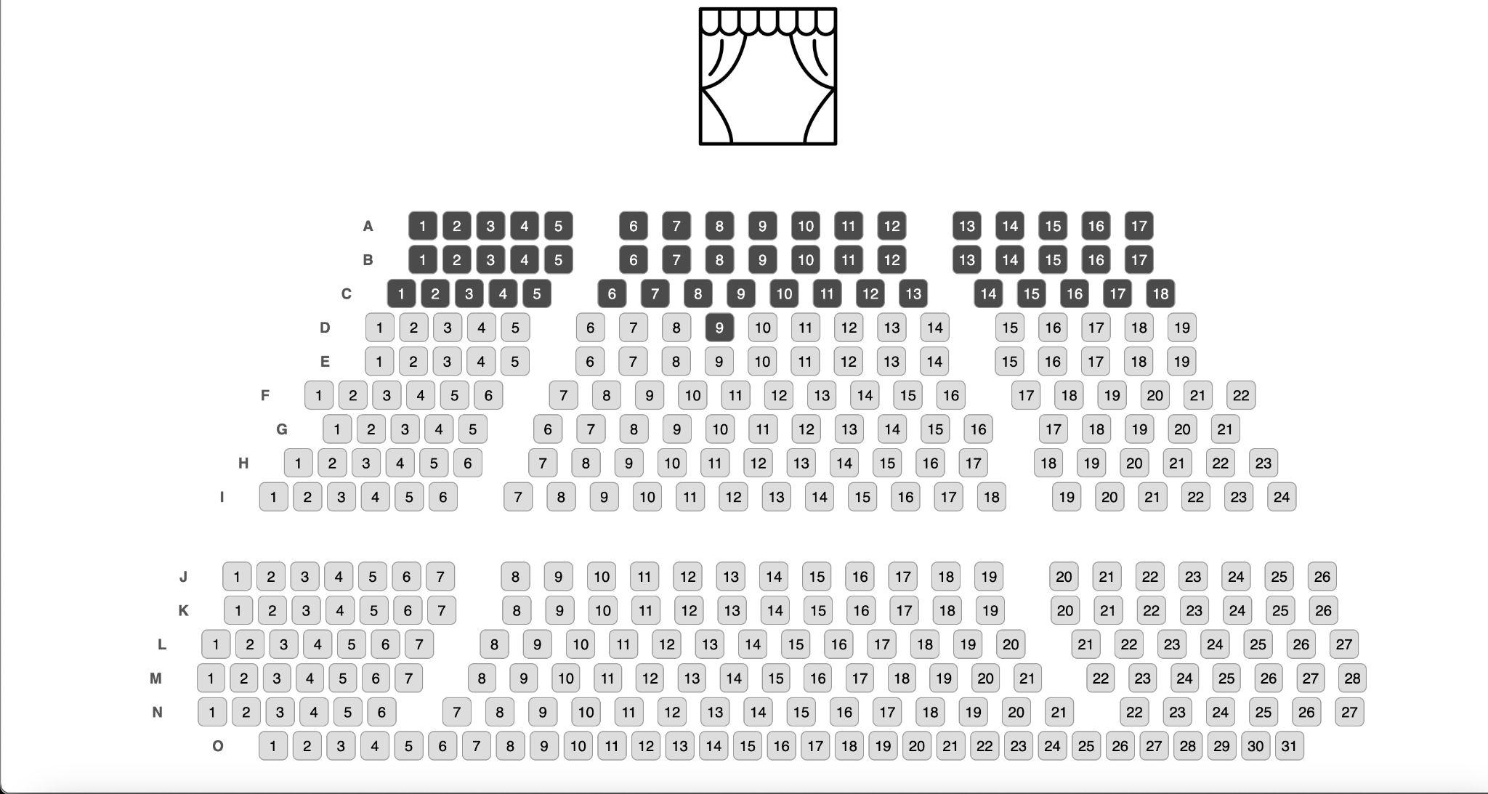
Seat Selection Page

Slide 6
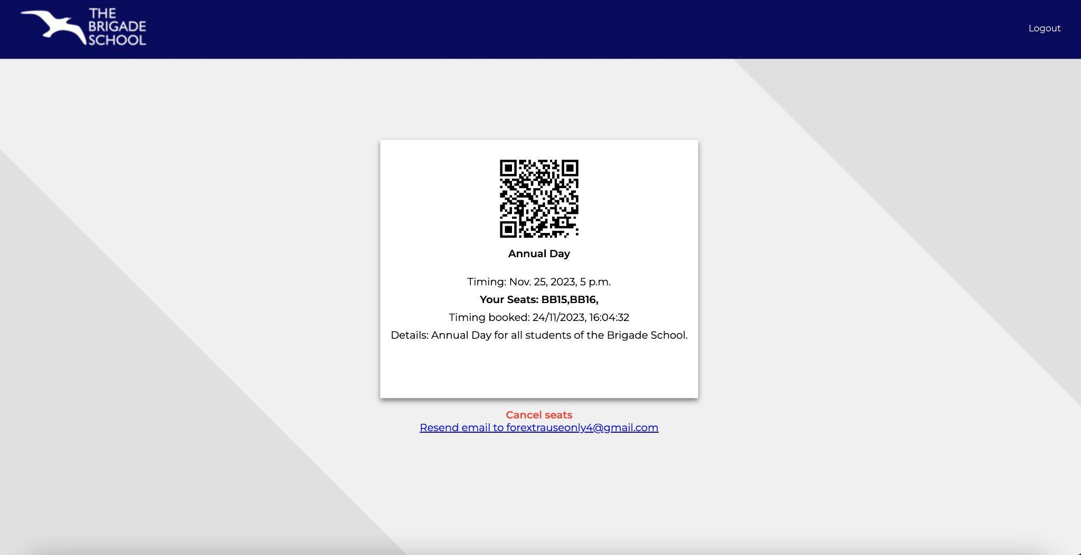
Ticket page

Slide 7
Email

Slide 8
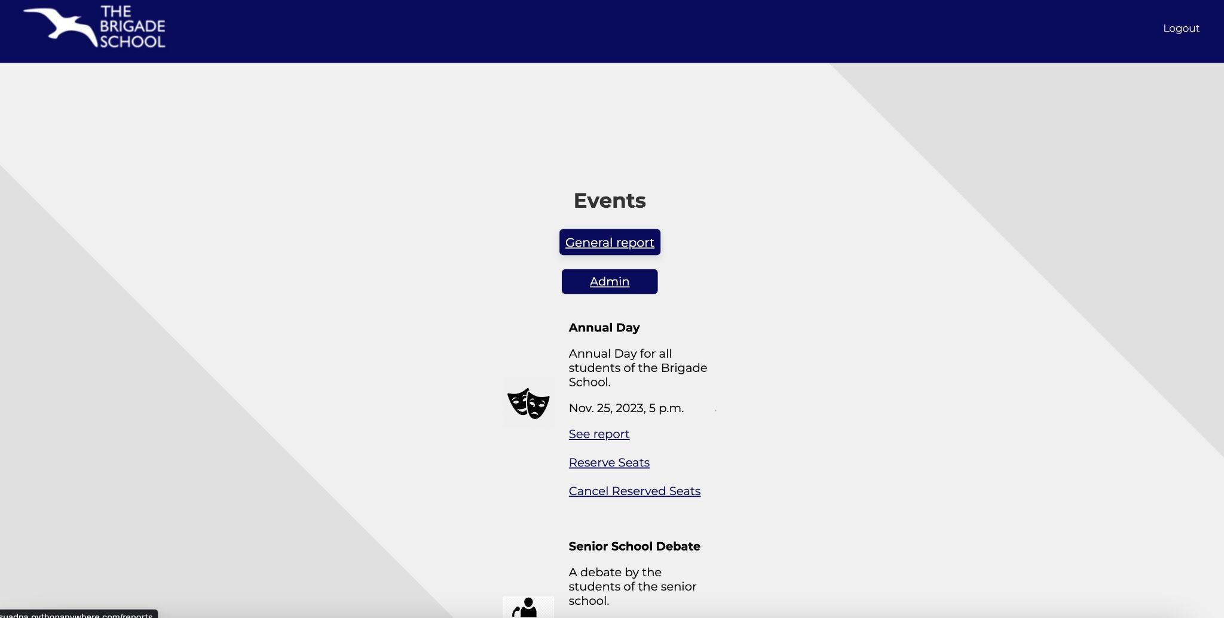
Admin

Slide 9
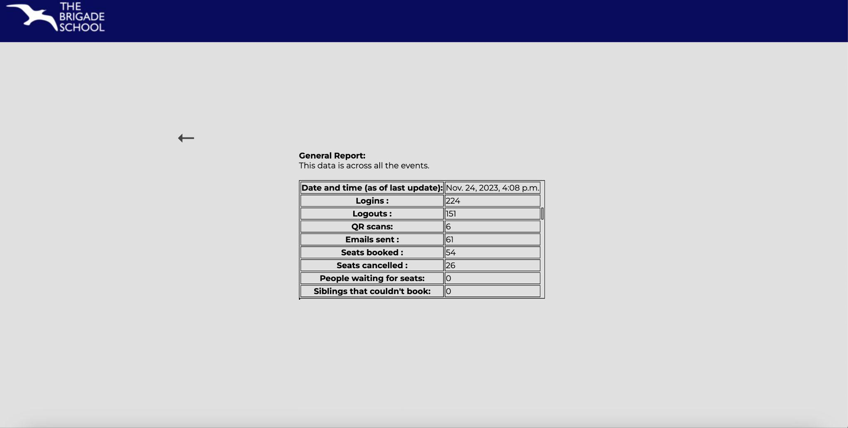
Admin General Report

Slide 10
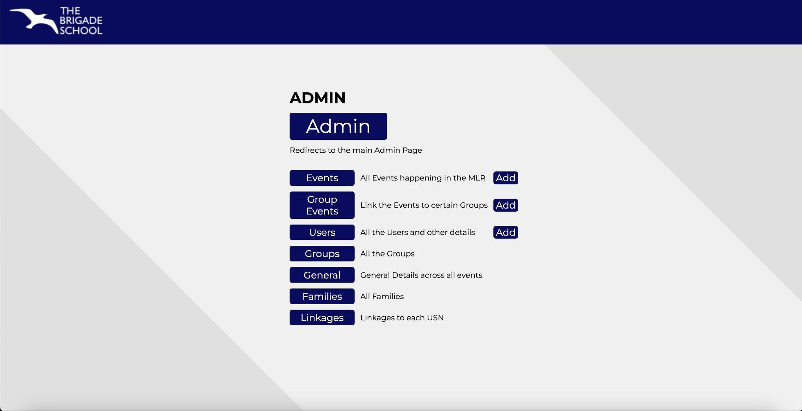
Admin Admin Features

Slide 11
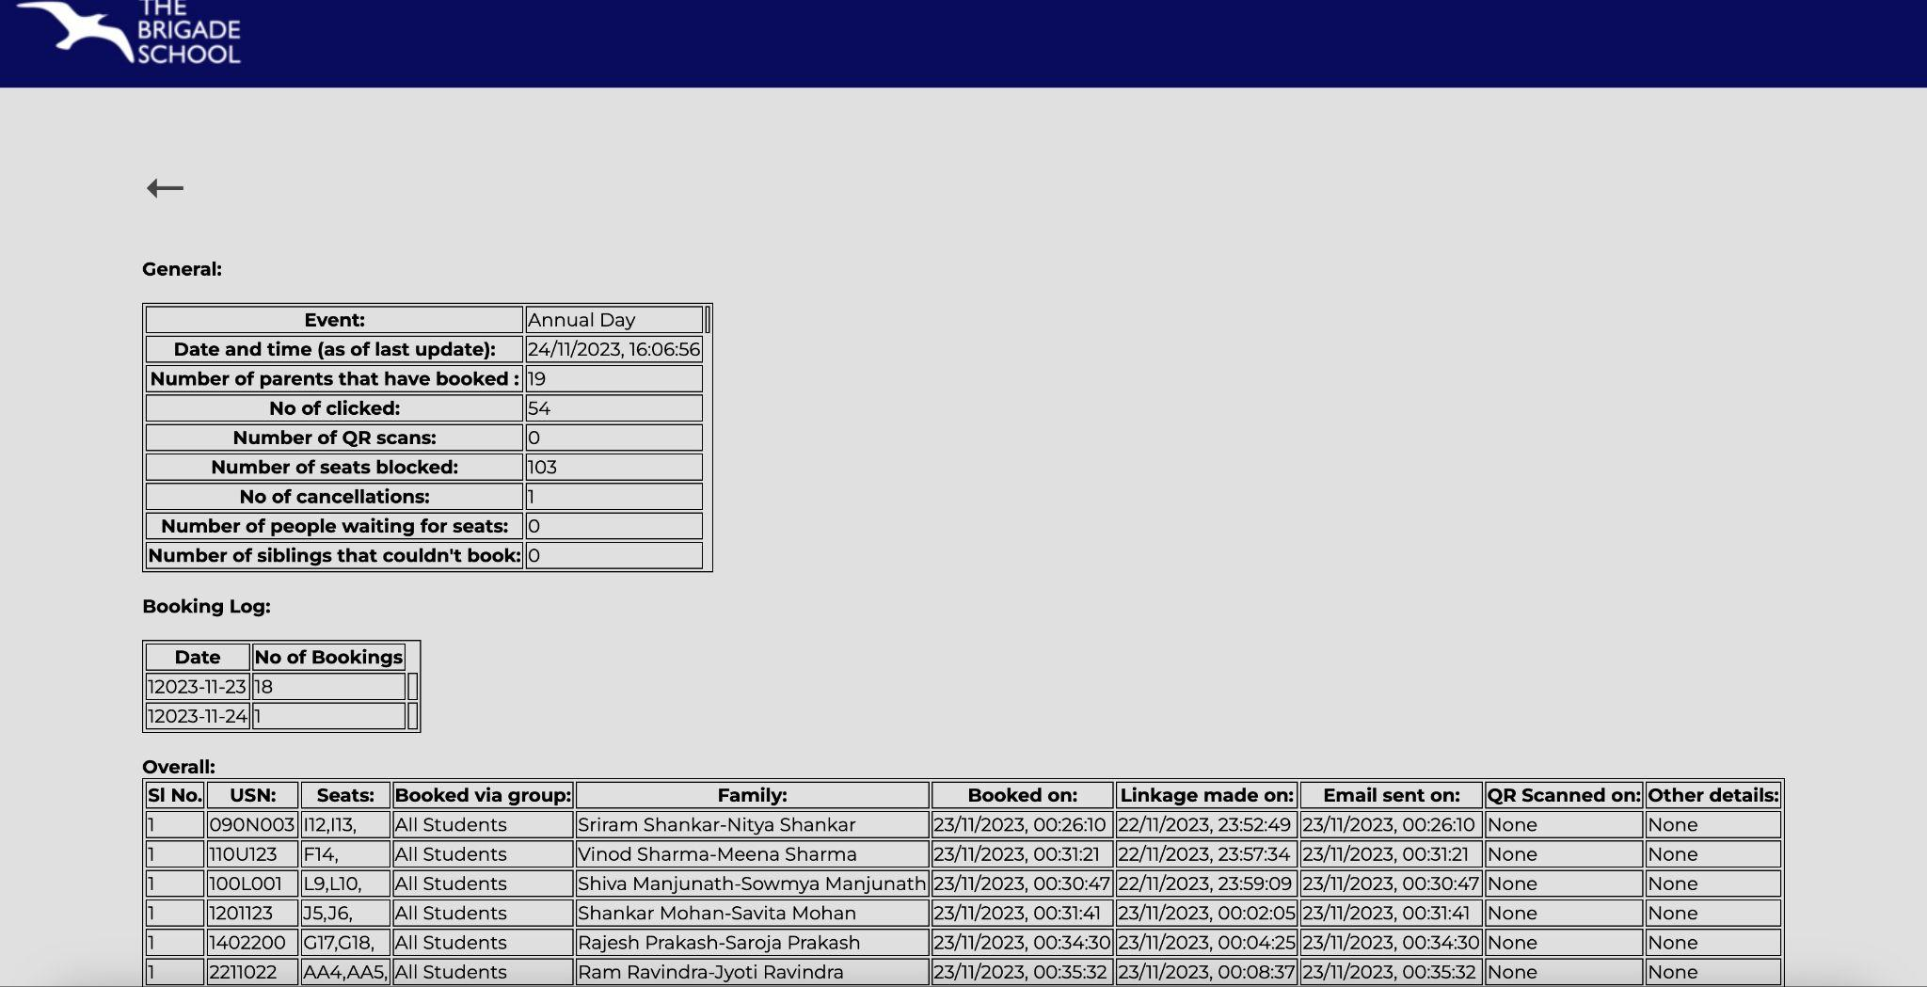
Admin
Event Report

Slide 12
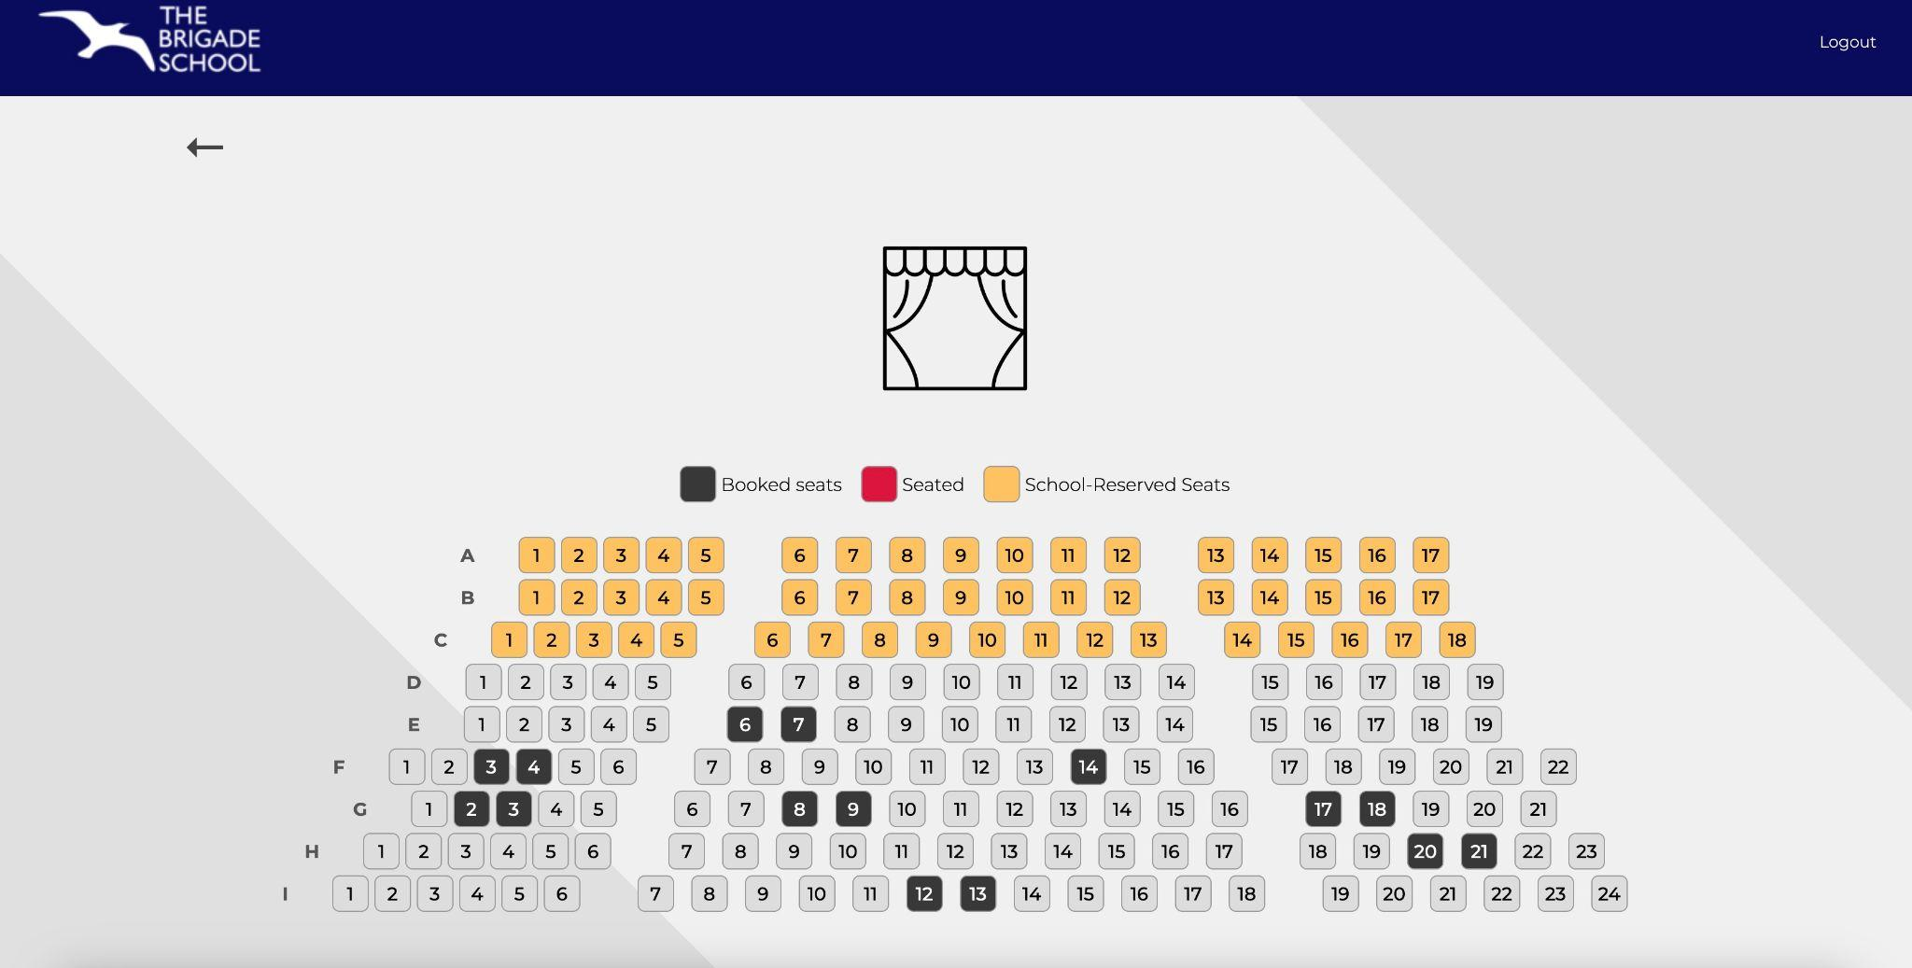
Admin Auditorium Status

Slide 13
Thank You

